Slide 1
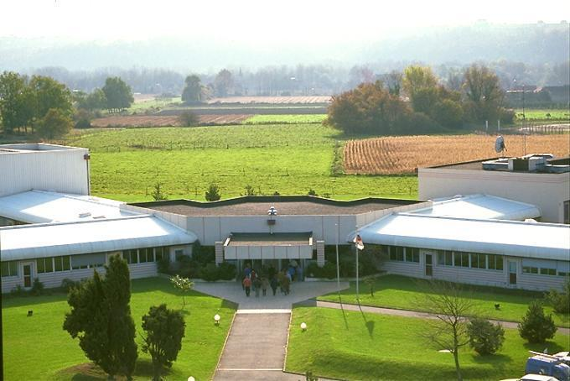
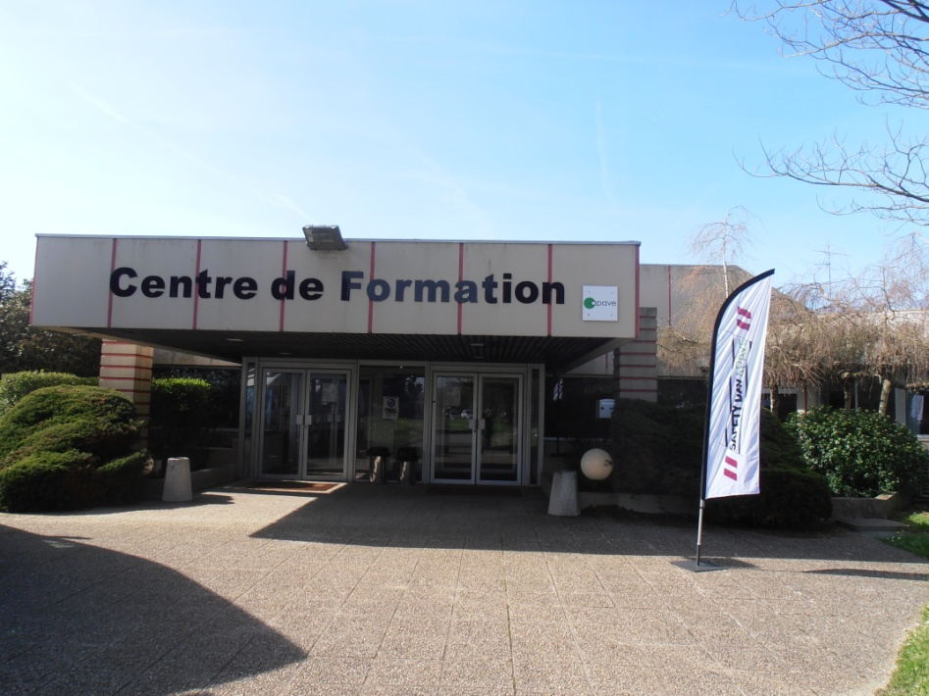
Lacq Training Centre

Slide 2
SAFETY INFORMATION
In case of fire :
Emergency exit
Fire fighting means
Plant alert :
Local alert, general alert ➔ Site managed
Major Incident ➔ Emergency Response Plan :
Public address information
Move to CONFERENCE room
Follow instructions given by the Safety representative
Keep calm

Slide 3
General presentation

Slide 4
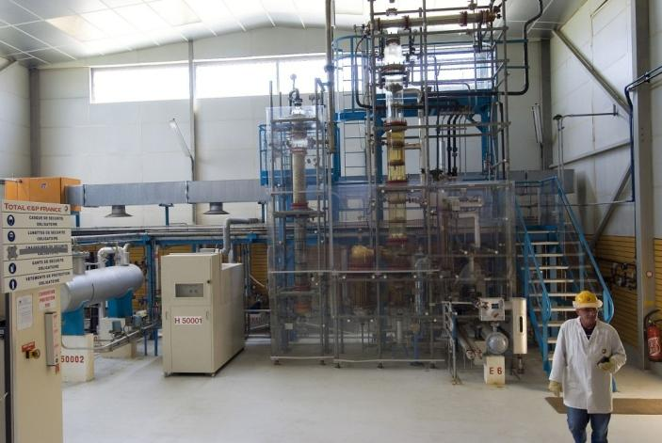
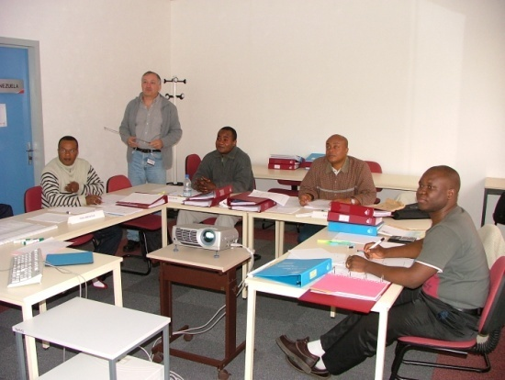
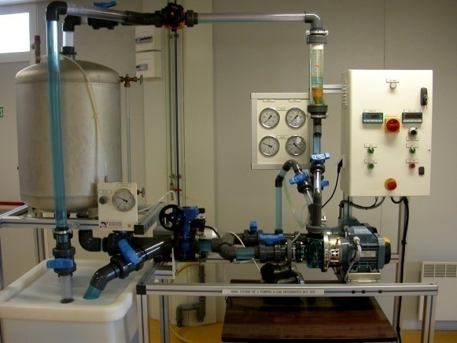
History
The CFL was a training centre of TOTAL (built by ELF) specialized in Oil and Gas, Chemical and Process Industries
Several educational and innovative means were invested in this center to propose efficient and unique trainings
In 2012 APAVE and TOTAL signed an agreement to take over the CFL and all of the activities

Slide 5
Objectives
The aims of APAVE Lacq Training Centre are :
To provide training solutions and to develop professional skills of the personnel from the Oil & Gas and Petrochemical industries in Operation, Maintenance, Safety & Environment
To use the Centre and its tools to develop all APAVE training offer
To propose specific training modules adapted to our clients needs
To offer specific pedagogical engineering for industrial projects

Slide 6
Our pedagogical means
Lacq Training Center is equiped with the following means :
12 training rooms (capacity : from 8 to 40 people),
1 conference room (70 seats),
1 video conference room,
5 pedagogical platforms :
1 pilot area and its control room
1 room dedicated to process simulator (OTS: Operator Training Simulator)
1 lifting platform (CACES®)
1 technical platform in partnership with SOBEGI
5 technical rooms :
1 mechanical room
2 high and low voltage rooms
1 maintenance and instrumentation room
1 automation room
1 asbestos room

Slide 7
Key figures
A centre known locally, nationally and internationally in Oil & Gas/ Chemical training offer
Turnover : 4 millions €
2 369 training sessions in 2015
12 526 trainees en 2015
1 team of 16 people :
1 Training Centre Manager: Fabrice ROCA
A Sales and Development team comprising 2 Training Commercial Advisers and 4 Sales Assistants
An Administrative team of 9 people

Slide 8
Trainers’ experience and skills
Trainers coming from different APAVE fields of intervention in the industry :
Electricity
Mechanic
Welding inspection (Non destructive Test)
Instrumentation & control
Safety & Environment
Organization …
A team strengthened by experienced Instructors-Training designers coming from Oil & Gas and Chemical industries exploitation

Slide 9
Pedagogical equipments

Slide 10
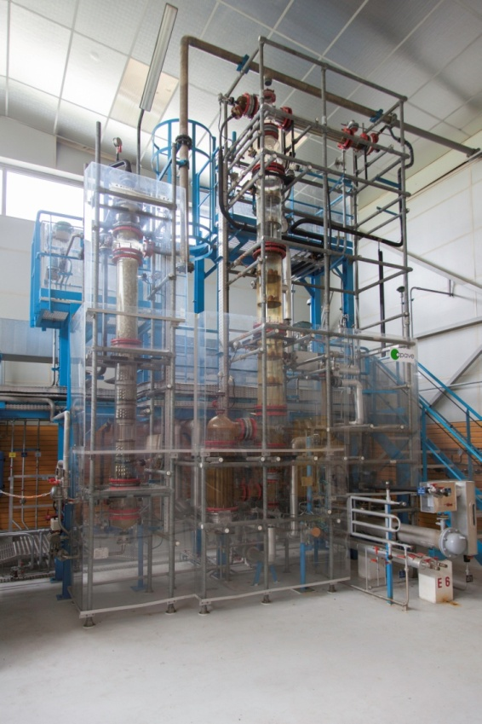
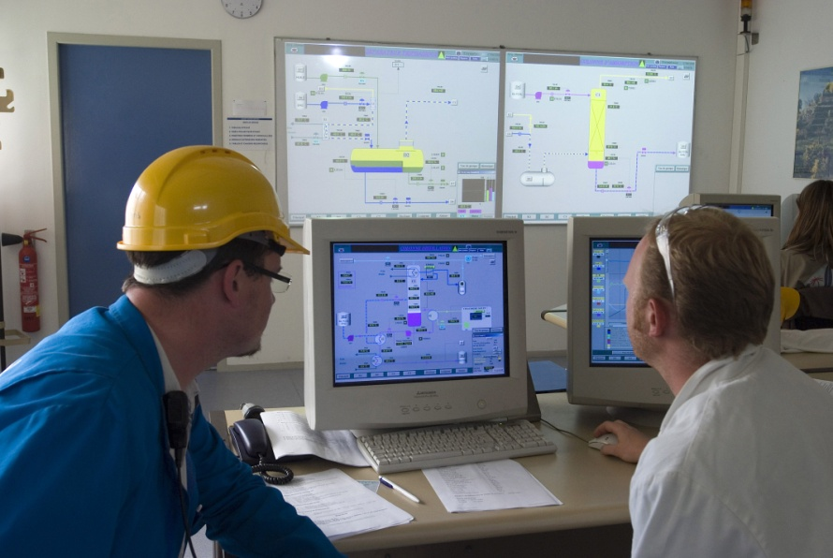
The pilot area
The pilot is a teaching industrial unit with a three-phase separator, gas compressor, absorption and distillation columns
The unit is driven from a control room through a set of control equipment and DCS (Distributed Control System)
The pilot allows the following role-playing :
Start-up, Operate and Shutdown a unit in a safe way
Disruptions – incidents
Work management and team behavior

Slide 11
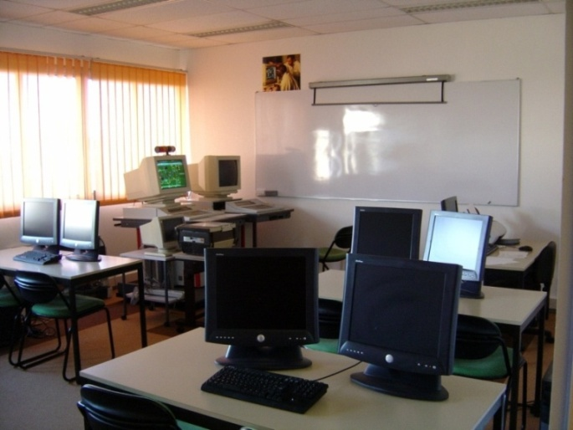
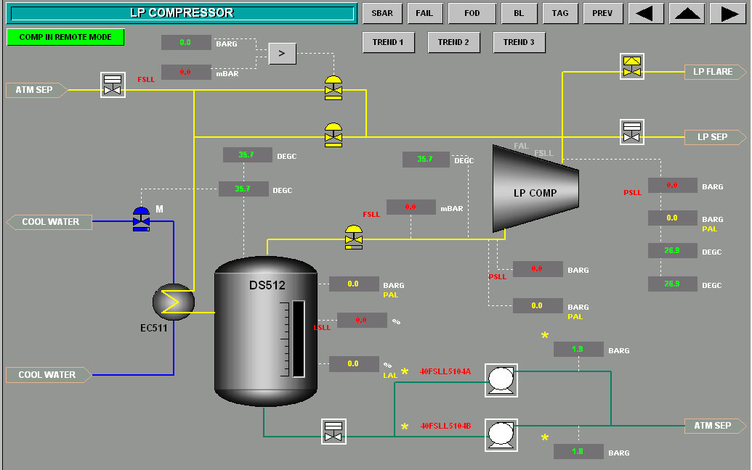
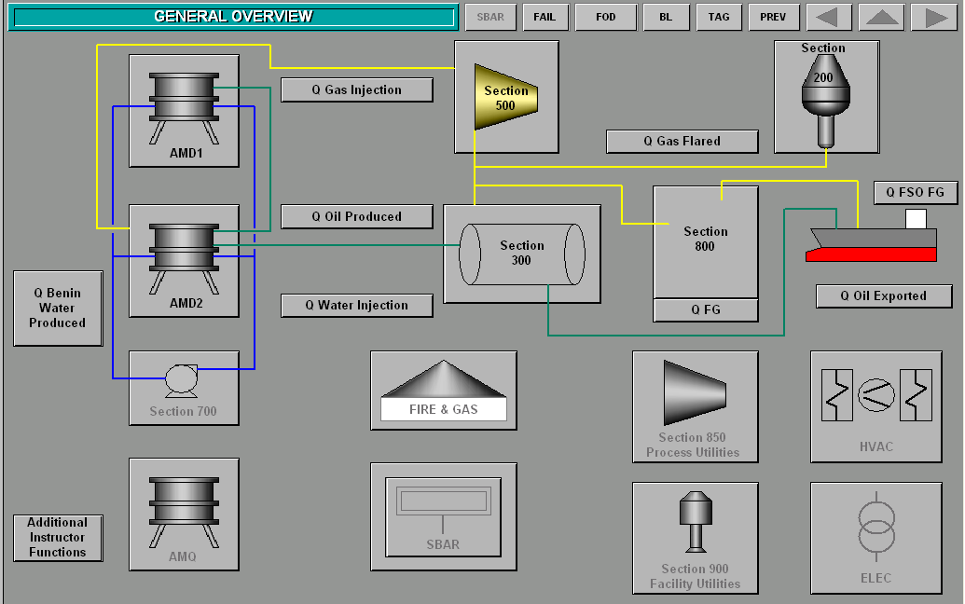
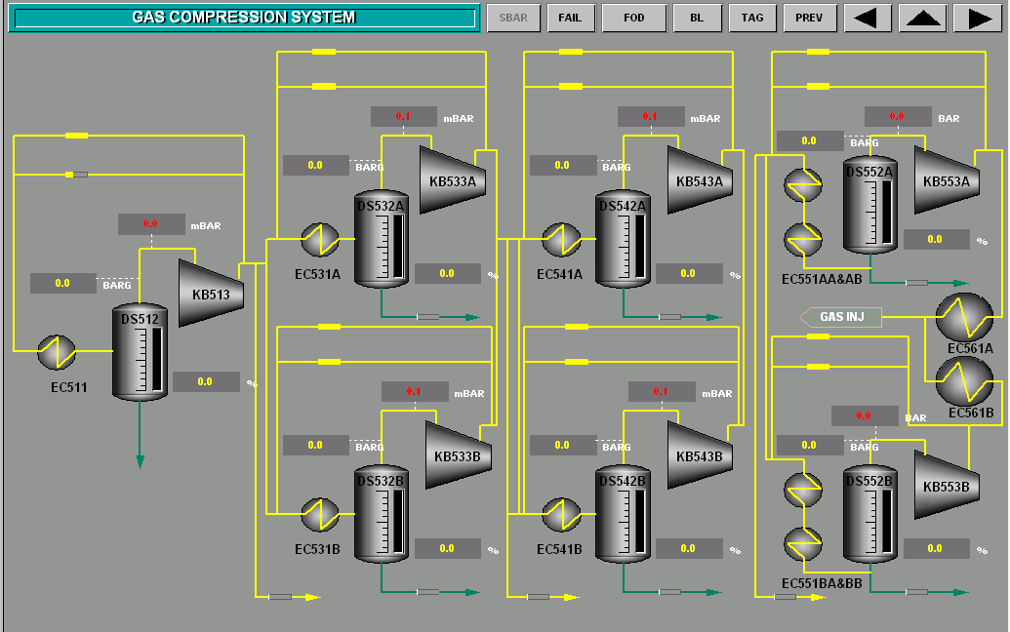
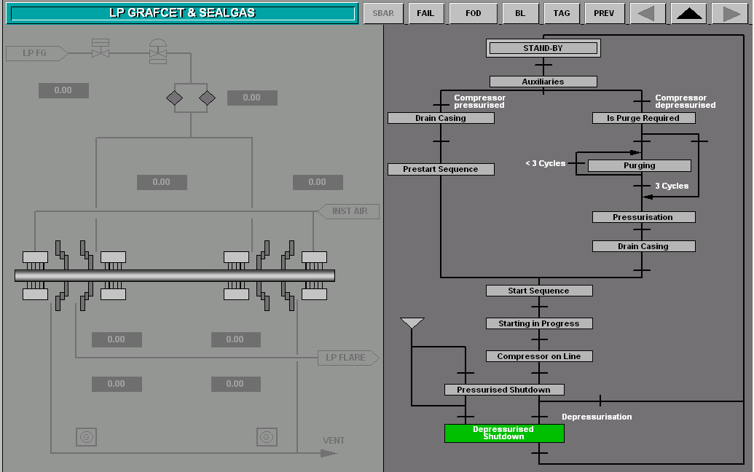
Process simulators
That room is dedicated to process simulators
A dynamic simulated oil platform (AMENAM KPONO) which allows trainees to learn all the operational phases
A dynamic simulator for distillation

Slide 12
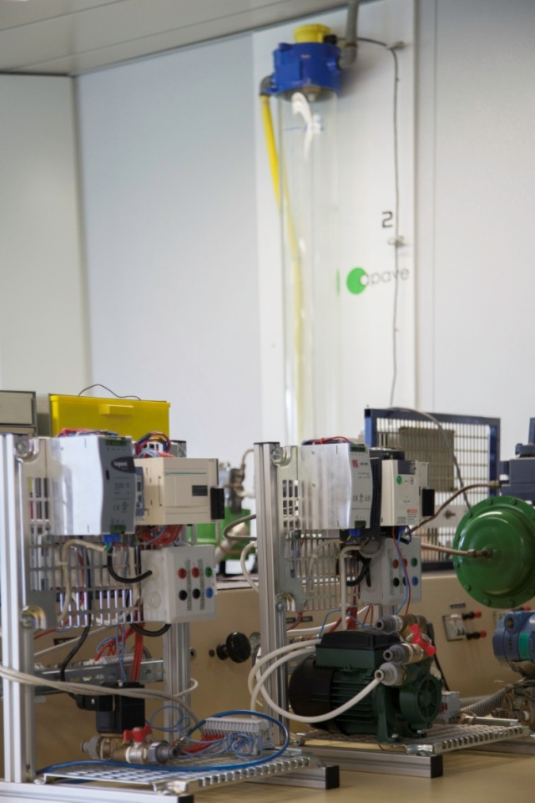
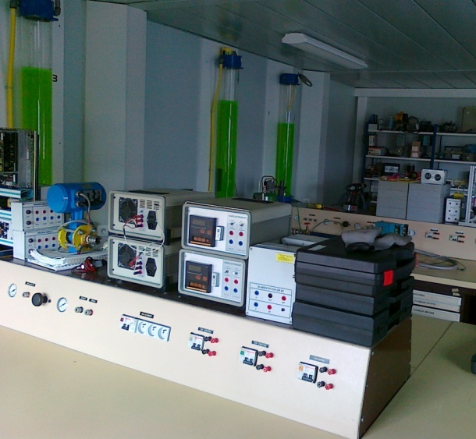
A control and instrumentation room
That maintenance room is dedicated to instrumentation and control.
Part of maintenance activities on transmitters and valves can be performed there, supplemented by interventions on the teaching pilot unit.

Slide 13
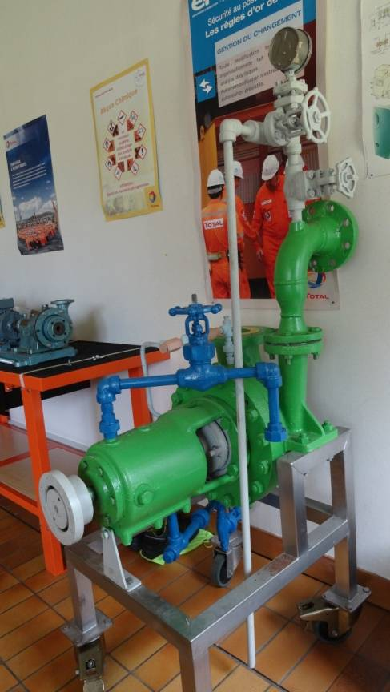
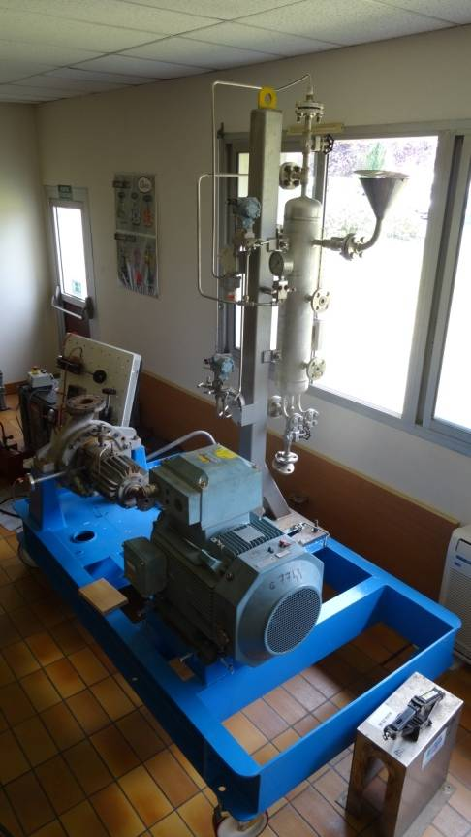
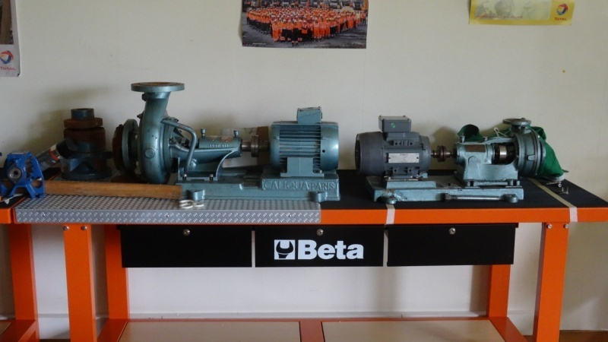
A mechanical room
Various types of pumps permit the following training :
Establishment of circuits (parallel and series)
Study of a centrifugal pump.
Study and cavitation visualization
Static materials (valves, tap, shutoff valve, pressure/Flow/Temperature transmitters, …)
Dynamic materials (compressors, multistage pump, steam turbine)

Slide 14
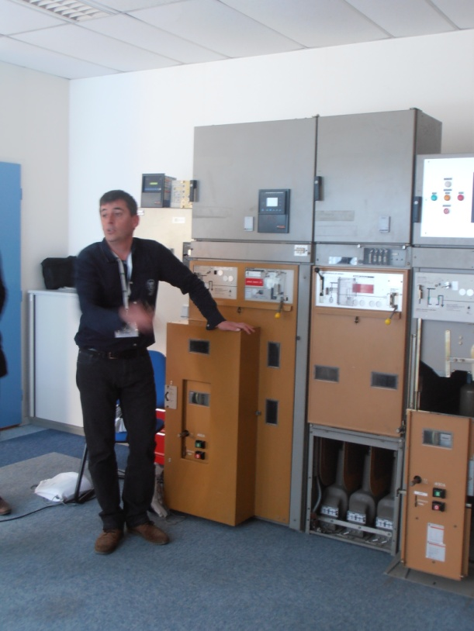
Electrical rooms : high and low voltage
Two electrical rooms dedicated strengthen your employees’ competences on all the electrical safety and technical issues, high and low voltage :
Basis
Conception
Application
Maintenance

Slide 15
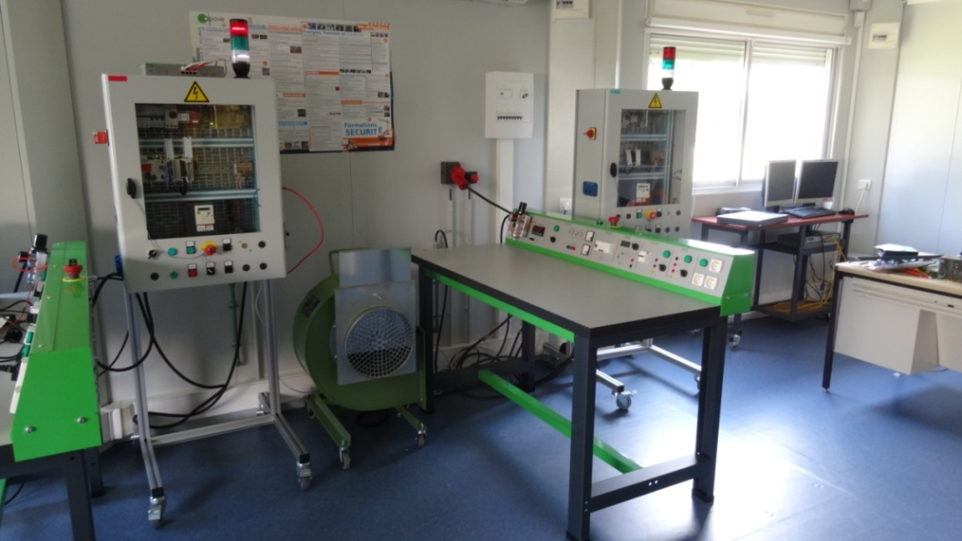
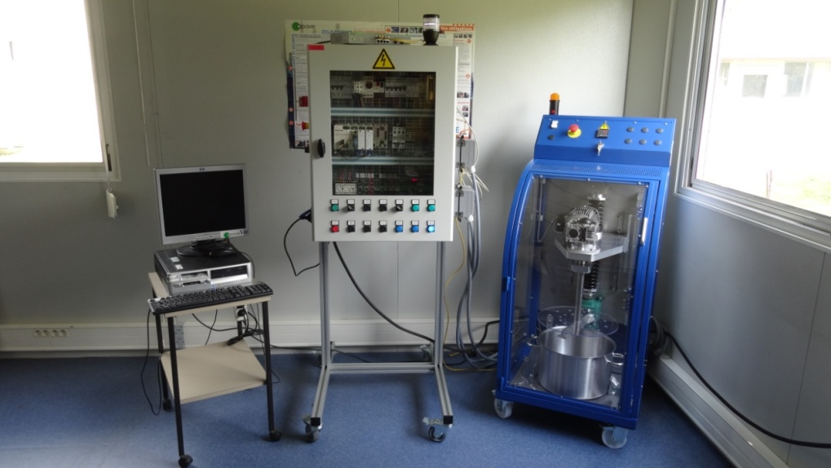
Automation room
A room dedicated to automatism programming and maintenance
Discover and/or increase knowledge about automatisms and the environment of the controller
Input / output card, communication card
Sensors
Actuators
Monitoring control

Slide 16
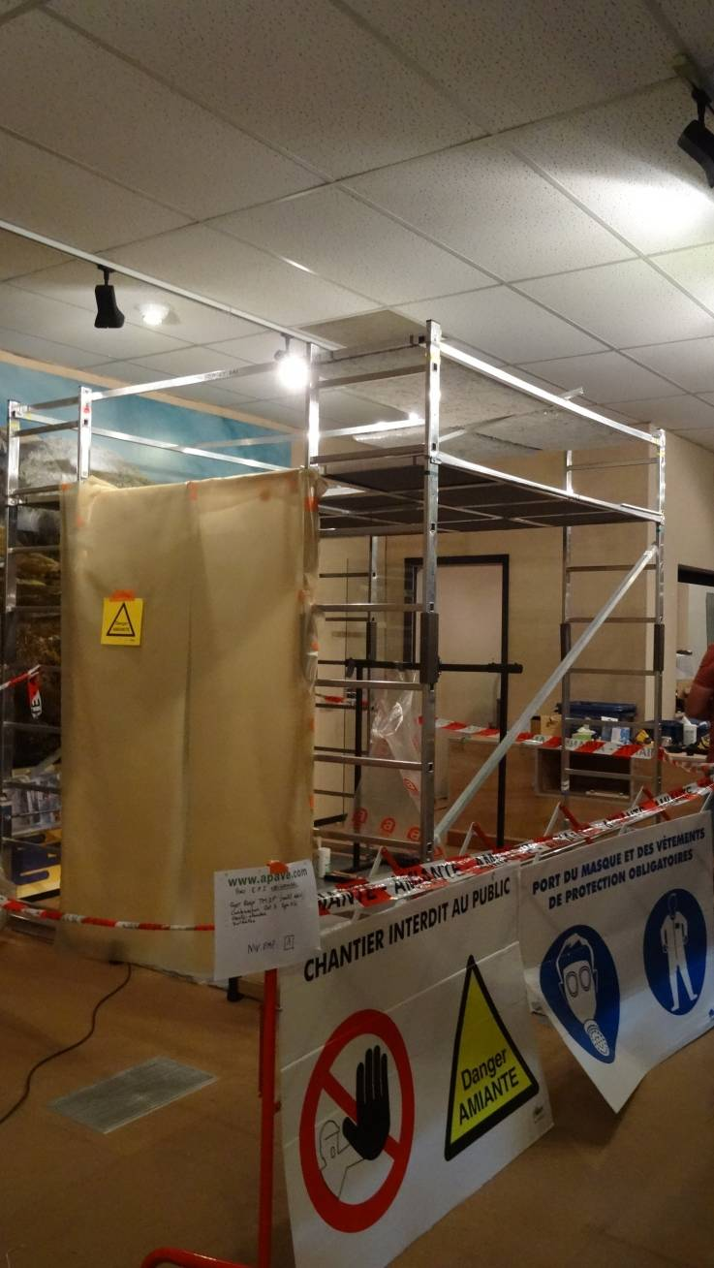
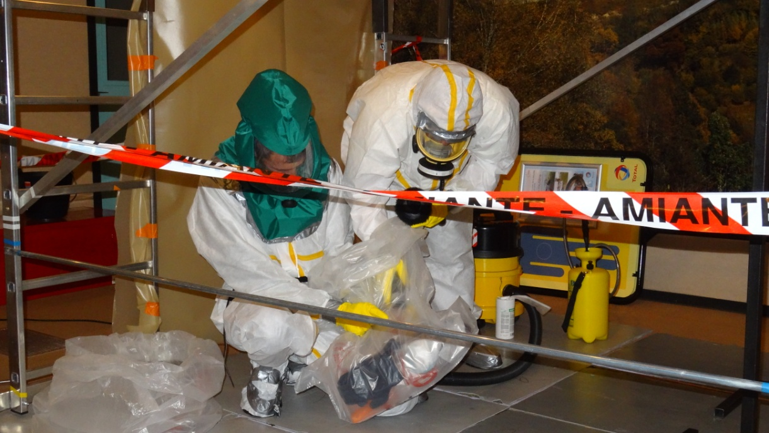
Asbestos teaching platform
A teaching platform with equipment for interventions on plenum or false ceilings, on floor or wall coatings, on laggings or boilers, on ducts, on flanges and gaskets, on maintenance, drilling and coring…

Slide 17
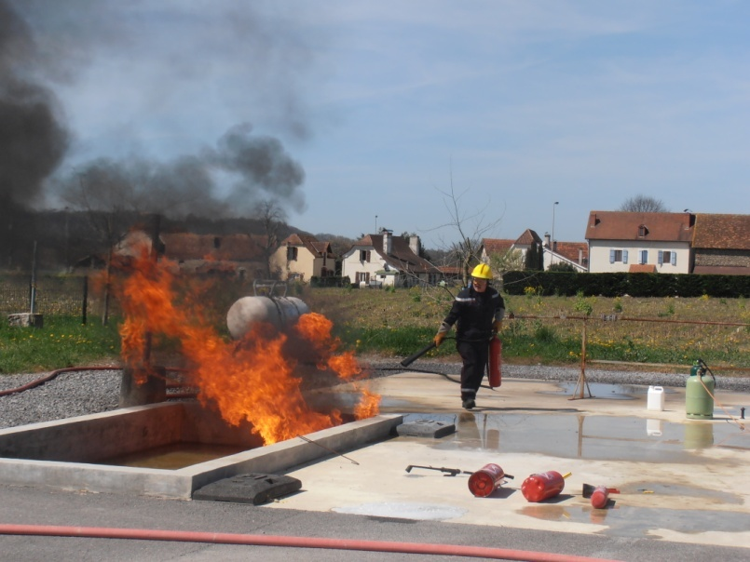
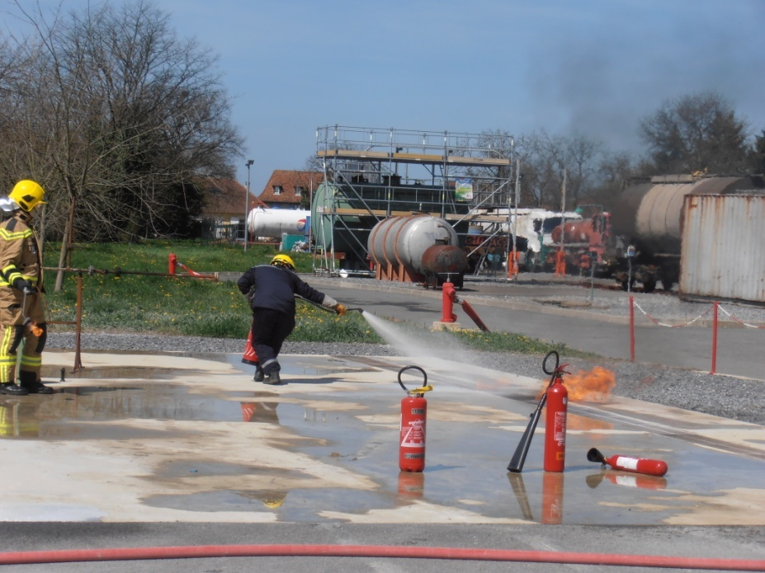
Fire fighting
The Lacq Training centre is equipped with a fire platform (SOBEGI)
Flange, gutter, flare, fosse, gas shutoff valve,
Control equipment against fire : fire extinguishers, poles, fire hoses…

Slide 18
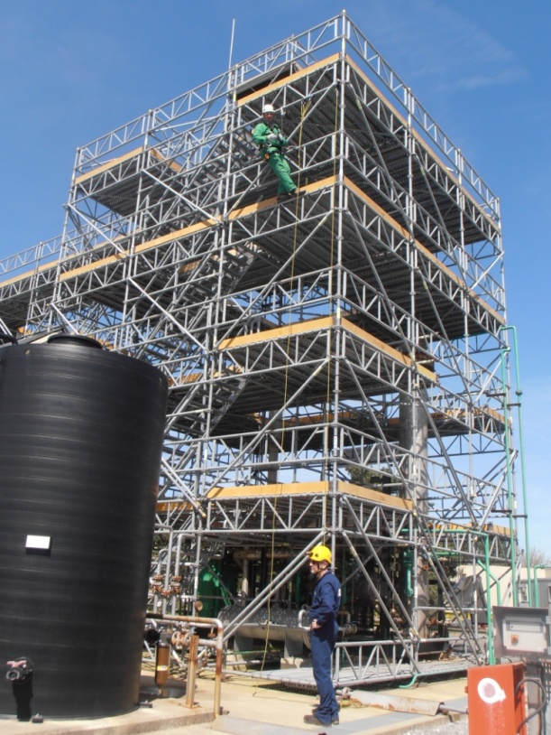
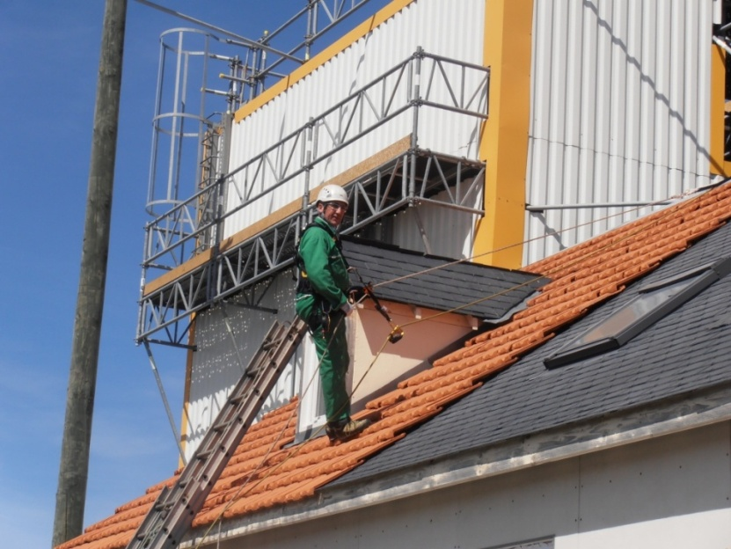
Lifting and handling, scaffolding
The Lacq Training Centre is equipped with
A 16m high operating tower
A multi-materials 7m high and 375 m² open warehouse
A 7.5m well and buried horizontal pipe

Slide 19
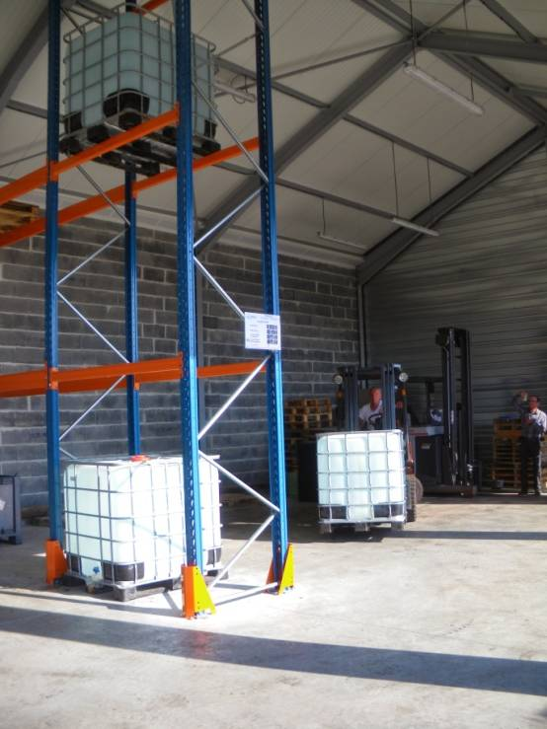
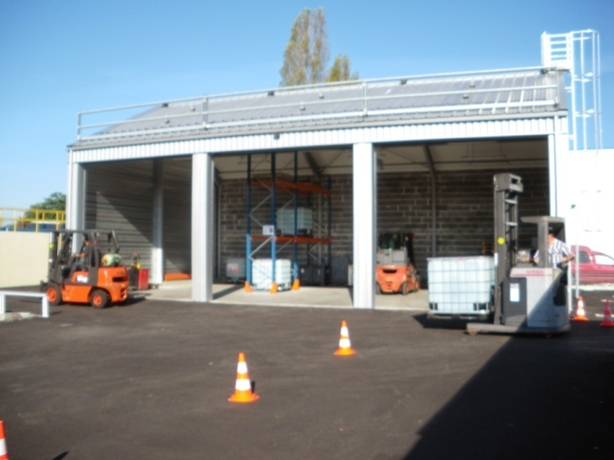
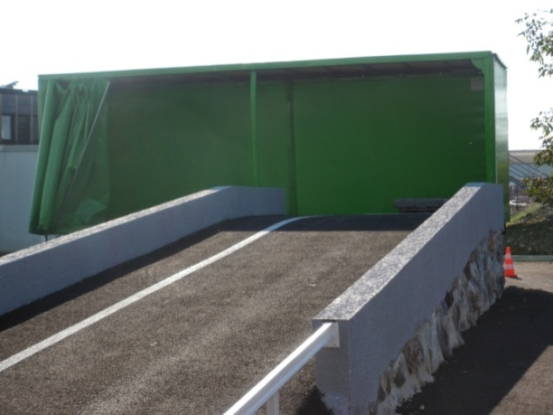
Lifting
The Training Centre proposes several lifting equipments for demonstration and practical exercises
That platform permits to organize all the trainings linked with heavy plant machinery

Slide 20
Specific training modules
Examples of realisation

Slide 21
Exploitation-Production Training
Modules developed for the exploitation and production :
Operational safety
Theory and practical conduct of a process :
Separation
Dehydration
Distillation
Gas compression…etc.
Technology of the equipment:
Pumps
Separators
Wells
Exchangers …etc.
Role-playing in a pilot platform or a simulator

Slide 22
Specific Pedagogical Engineering for Industrial Projects (CLOV, MOHO NORD…)
To prepare staff to on-site operation so as:
to succeed in starting-up the installations in the respect of the project objectives,
to enable the installations to be run safely and efficiently during the field life.
How? By providing a specific training for the future installation. It includes:
Detailed description of each part of the process (functional analysis, localization, subsystem description….)
Focus on the safety issues
Description of the operating and maintenance conditions
Description of the operating procedures
The training modules construction are based on technical information and specifications provided by Project Engineering: basis of design, calculation notes, data sheets, computer data, specifications, drawings, plans, sketches, models, procedures, functional analysis…

Slide 23
Maintenance Training
Modules developed for the maintenance
Operational safety
Technical modules that deliver professional certification diploma :
Electricity
Dynamic equipments’ mechanics
Static equipments’ mechanics (general mechanics)
Instrumentation – Control - Automatism
Modules with methods:
Breakdown analysis
Predictive maintenance

Slide 24
Maintenance Training
As part of projects (AREVA, SOGARRA)
Setting up of courses specifically adapted to the needs of a company as part of a project or a process of recruitment.
As part of the course
Electrical maintenance technician
Instrumental maintenance technician
Sporadically
Adjustment, test and optimization of the protective frame
Working and adjustment of a central with electric alternators

