Slide 1
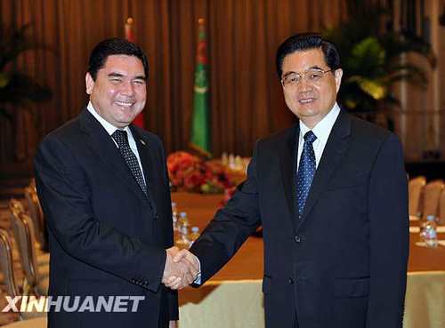
PhD Dissertation
Caspian Region Environmental and Energy Studies Center, Berlin
The East Corridor of Turkmen Gas Export
By Igor Korobov (2015)

Slide 2
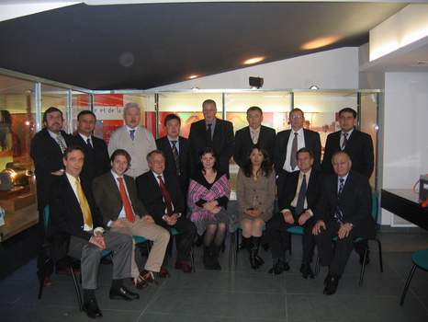
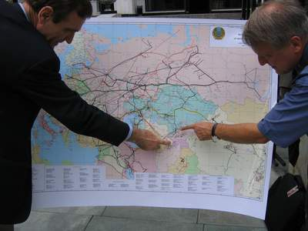
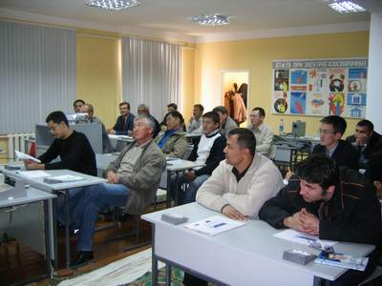
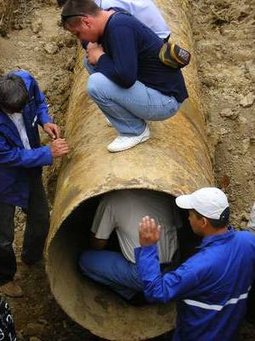
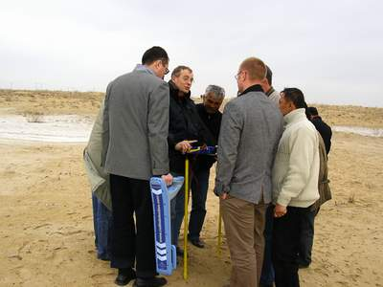
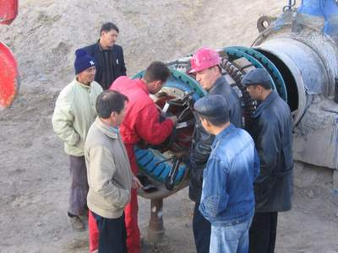
Technical Audit Pipelines @ PNIS
Notes:
Formation en salle des techniciens des 4 pays et sur site

Slide 3
Research Question
What factors of the Turkmenistan energy policy have led to the construction of the Turkmenistan-China (TC) gas pipeline and what are the implications for the energy policy of Turkmenistan?

Slide 4
Topics to be clarified
How historical, infrastructural, geographic and economic aspects influenced the development of the Turkmenistan’s energy policy?
Why was China interested in Turkmen gas?
What strategy was applied by China to convince Turkmenistan?
What were the other pipeline possibilities for Turkmenistan on the table and how they differed from the pipeline project in focus?
How the implementation of the TC project influenced the de-facto diversification?

Slide 5
Gas Pipeline Projects since 1991
Transcaspian (Nabucco, White Stream, TAP, TANAP, etc.)
Turkmenistan – Japan (via China)
Transafghan (TAPI)
Caspian Costal (to Russia)
Turkmenistan – Iran
– Turkey – Europe
– Pakistan – India
– Persian Gulf
Turkmenistan-Afghanistan-Tajikistan-China
Transasian (Turkmenistan–China)

Slide 6
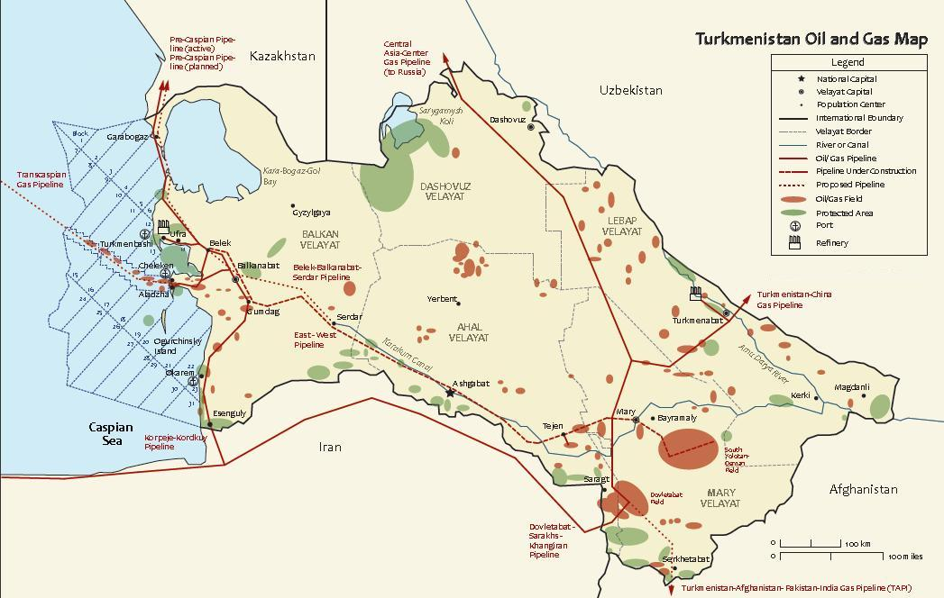
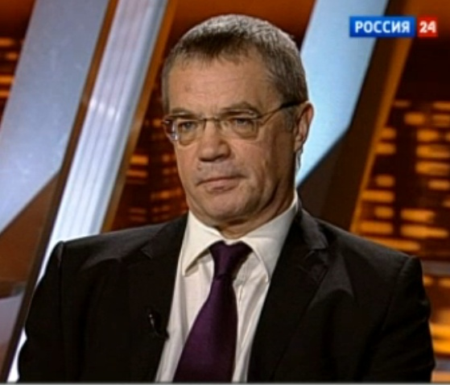
“One must not forget that Soviet geologists have virtually built the fundament of Turkmenistan’s gas industry, and even though the new data appears, the initial data nevertheless reflects the [actual] potential...
There are no grounds for statements that the [gas] field are of such extensions... The new fields are not simple and gas there is complex. Serious investments are required.”
Alexandr Medvedev,
Vice-Chairman of Gazprom
Source: VESTI Channel, 18.11.2011. Retrieved from http://www.vesti.ru

Slide 7
Gas production & consumption in Turkmenistan, 1985-2013
Source: BP (2014)

Slide 8
Turkmenistan’s Gas Reserves
Reserves assessments in 2010
BP 8.00 Tcm
Turkmenistan 26.2 Tcm
International Audit of gas reserves in 2008.
Gaffney, Cline & Associates on South Yolotan, Osman and Yashlar fields
Year | 1997 | 1998 | 2008 | 2010 | 2011 | 2011 | 2012 | 2013
Tcm | 2.4 | 2.3 | 7.94 | 8.0 | 13.4 | 24.3 | 17.5 | 17.5
Source : BP (2002-2014)

Slide 9
Turkmenistan energy policy
Gas sale at the national borders
Avoids investments in pipelines outside
Avoids transit issues
State monopoly on pipeline infrastructure
No ownership in onshore gas projects for foreign companies
No guaranteed volumes to buyers
Yearly renegotiation of contract terms
Goals
Gas buyer diversification
Transfer to indexed-pricing in gas trade

Slide 10
The Change in the Energy Policy
Turkmenistan has been using pipeline projects, both constructed and discussed to bargain a better gas price
Turkmenistan had to reconsider its energy policy in a number of directions:
- to accept a lower gas price
- to allow foreign ownership in onshore gas projects
Turkmenistan has switched dependence from Russia to dependence from China.

Slide 11
Major Actors
  Russia/ Gazprom as the traditional actor
    blocking Central Asian gas supply to EU
    uninterested in Turkmen gas, due to the high price, but forced to buy due to:
      the gas contact in place
      preserving political influence in Turkmenistan
    offered to participate in TAPI
  Iran, the regional power
    blocking Central Asian gas supply to EU
    blocking Central Asian gas supply to Pakistan and India
    uninterested in Turkmen gas, due to the high price, but forced to buy due to:
      the contact in place
      preserving political influence in the country
  interested in European, Pakistani, Chinese gas market
  interested in cheaper Turkmen (barter deals) gas for its northern regions
  interested to be a reseller of the Turkmen gas rather that a transit country

Slide 12
Minor Actors
European Union
  diversification
    Reduction of Russian political influence
USA, purely political
  political support for the TAPI
    to initiate China-India tensions over energy
  political support for the Transcaspian
India
  in cheaper gas
  diversification
Pakistan
  interested in cheaper gas
  diversification
  possible political influence on India
  more interested in Iranian gas
Kazakhstan
  potential main actor

Slide 13
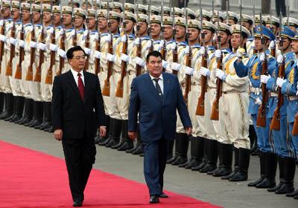
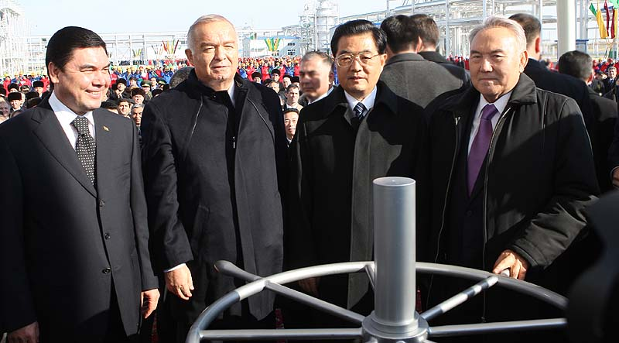
How it has started
April 3, 2006 General Agreement on gas pipeline signed by Niyazov
July 17, 2007 PSA signed
July 17, 2007 Gas purchase contract for up to 30 bcm by 2013
June 24, 2009
Contract extended up to 40 bcm by 2014
September 4, 2013
Contract extended to 65 bcm

Slide 14
Why did China «choose» Turkmenistan?
China has reserved a bargaining “card” for future gas trade
Price in Turkmenistan was lower than price offered by Russia
Loan requested US$ 4 bln vs. US$ 25 bln for gas field development
Internationally weak Turkmenistan lacked support from the West and no longer had strong political ties with Russia (gas supply disruption in 1997 and 2009)
Turkmenistan can be vulnerable to a pressure related to gas supply stability and beneficial gas pricing
A possibility of expanding political influence onto the transit countries (Kazakhstan, Uzbekistan, Kyrgystan)
China’s interest in upstream projects was satisfied

Slide 15
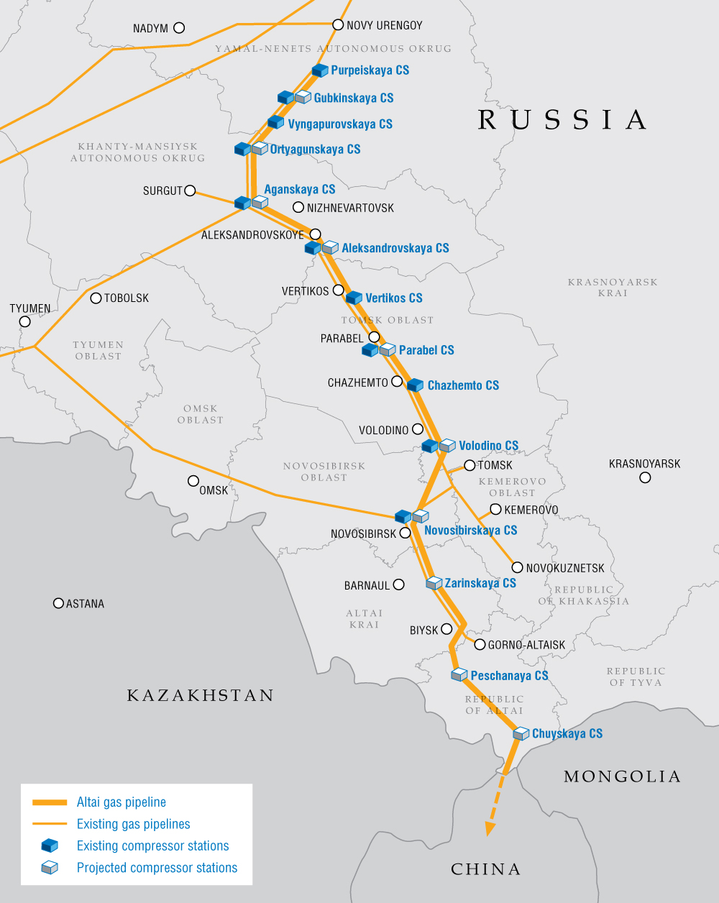
Altai gas pipeline
Length: 2,600 km
Capacity: 30 bcm/ year
Resource base: Kovykta
Est. reserves: ~ 2 tcm
Owner: Gazprom
Memorandum of understanding signed in March, 2006
The export contract WAS expected to be signed in mid-2011.
First supplies are planned for late 2015. Contract period will be 30 years.
Source: Gazprom (2011)

Slide 16
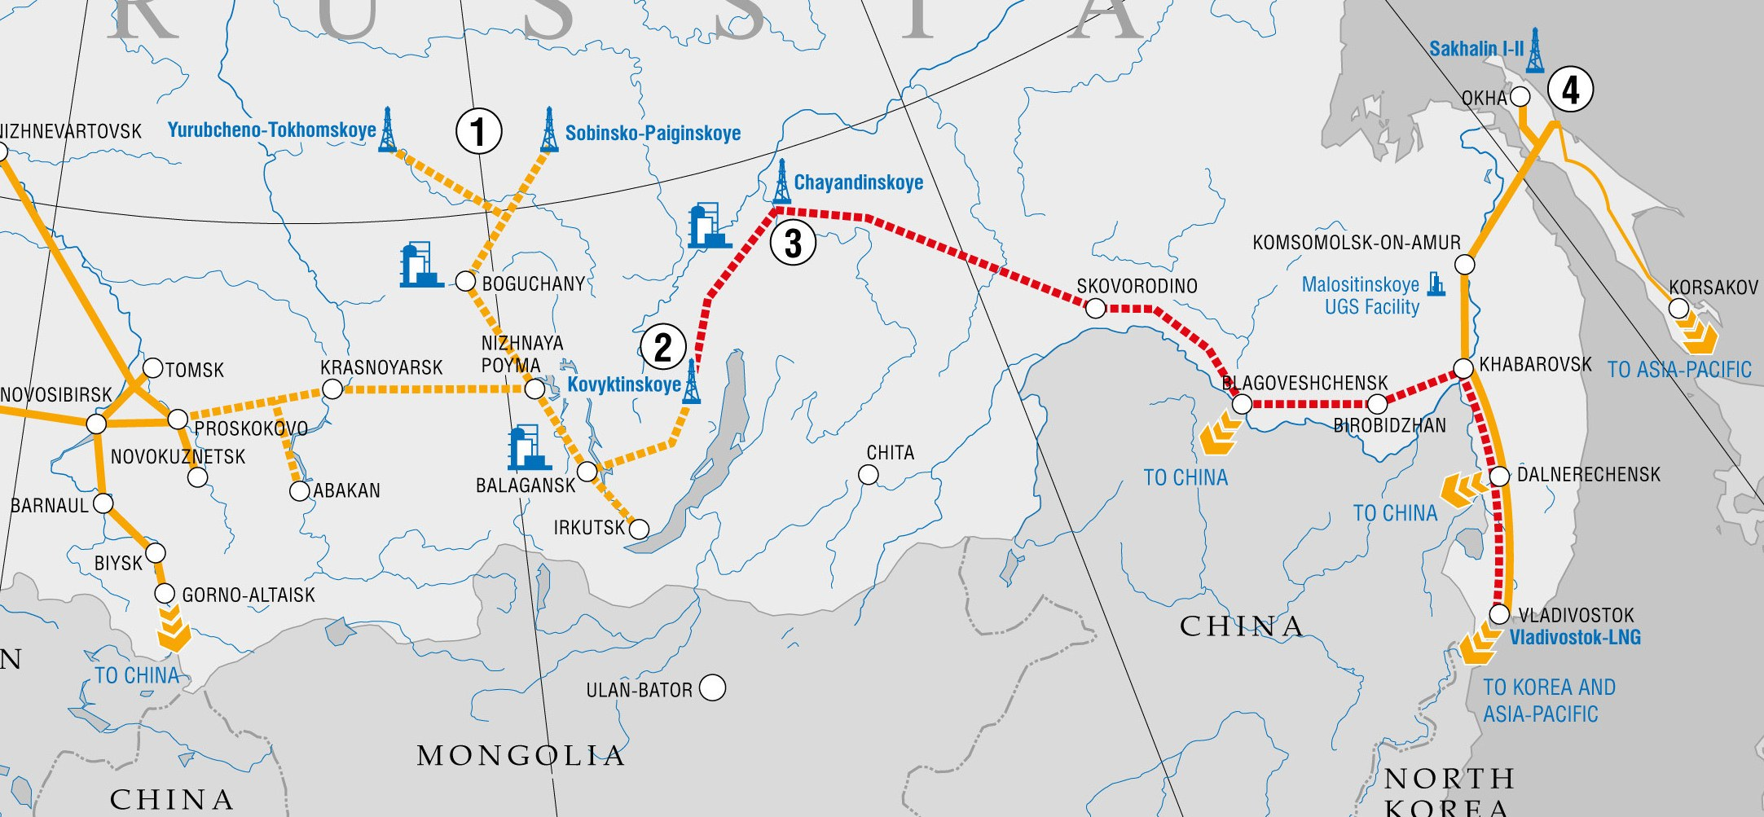
Power of Siberia Project
Annual capacity: 60 bcm
Estimated cost: US$ 46 to unlimited

Slide 17
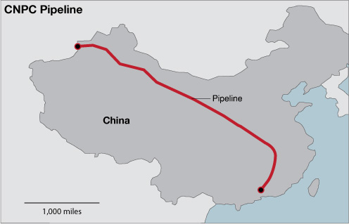
West-to-East gas pipeline, #
From Zhongwei (Ningxia) to Guangzhou (Guangdong)
Capacity was upgraded from 30 to 45 bcm
Length 2,477km
Cost $15 billion

Slide 18
Why Turkmenistan accepted the Chinese offer
Non-Russian gas pipeline
  A lack of trust after the 1996-1997 gas crisis
  Undermining the transit of Turkmen gas
  The cessation of gas purchase in April 2009
  A fear of Russian political influence on any pipeline involved
  This was confirmed by the refusal to consider Rosneft participation in TAPI
Maintaining control over main gas asset
  Obtaining preferential loans allowing a sole ownership over giant Galkynysh gas field
A lack of progress on pipeline construction with other projects

Slide 19
The Growth of China Influence in Turkmenistan
China’s influence significantly increased
Strategic Partnership. September 3, 2013
Military cooperation
35,000 workers involved into PSA
Upstream subcontract projects
Telecommunication business projects

Slide 20
What we know about the Contract
There are three contracts:
30 bcm
10 bcm
25 bcm
Number of pipeline legs: 4
Commissioned in full: expected in 2020
Duration: 30 Years
Type: take or pay
Price calculation: Indexed formula

Slide 21
Transasian (TC) pipeline
Length ~ 7000 km
(1,833-km line in Central Asia and 5,200 in China)
Launched on 14 December, 2009
Upstream contract: CNPC’s own production expected to peak at 13 bcm/year under PSA at Bagtyyarlyk.
China received 100 bcm by end of 2014
  66.3 bcm supplied by Turkmengaz
  26.7 bcm from PSA in Turkmenistan
    7 bcm from Uzbekistan and Kazakhstan

Slide 22
Gas import structure of China in 2010-2013, bcm
Gas exporting country | 2010 |  | 2011 |  | 2012 |  | 2013
 | LNG | Pipeline | LNG | Pipeline | LNG | Pipeline | LNG | Pipeline
Trinidad and Tobago | 0.07 |  | 0.5 |  | 0.2 |  | 0.15
Peru | 0.08 |  | 0.1
Belgium | 0.08
Russia | 0.51 |  | 0.3 |  | 0.5
Egypt | 0.08 |  | 0.2 |  | 0.4 |  | 0.6
Equatorial Guenea | 0.08 |  | 0.2 |  |  |  | 0.55
Nigeria | 0.17 |  | 1 |  | 0.4 |  | 0.5
Qatar | 1.61 |  | 3.2 |  | 6.8 |  | 9.2
United Arab Emirates | 0.08
Yemen | 0.7 |  | 1.1 |  | 0.8 |  | 1.5
Australia | 5.21 |  | 5 |  | 4.8 |  | 4.8
Indonesia | 2.45 |  | 2.7 |  | 3.3 |  | 3.3
Malaysia | 1.68 |  | 2.1 |  | 2.5 |  | 3.6
USA |  |  | 0.2
Turkmenistan |  | 3.55 |  | 14.3 |  | 21.3 |  | 24.4
Oman |  |  |  |  | 0.1
Algeria |  |  |  |  | 0.1 |  | 0.1
Kazakhstan |  |  |  |  |  |  |  | 0.1
Angola |  |  |  |  |  |  | 0.1
Other CIS countries |  |  |  |  |  | 0.2 |  | 2.9
Other Asia Pasific |  |  |  |  |  |  |  | 2
Other Europe |  |  |  |  |  |  | 0.1
Subtotal, bcm | 12.8 | 3.55 | 16.6 | 14.3 | 19.9 | 21.5 | 24.5 | 29.4
Total export, bcm | 16.35 |  | 30.9 |  | 41.4 |  | 53.9
Import Dependence on Turkmenistan, % | 21.72 |  | 46.28 |  | 51.45 |  | 45.27
Source: BP (2014)

Slide 23
Implications
The construction of new gas pipelines until China’s full “saturation” will be extremely difficult
The diversification goal of the Turkmen energy policy has not been achieved
HOWEVER, new routes for Turkmen gas export will still be on the agenda due to:
- attempts to achieve de-fact diversification
- relatively low price paid for Turkmen gas by China
Being legally and politically bound with China, Turkmenistan has less capacities to satisfy other gas buyers

Slide 24
Thank you for your attention!

